Slide 1
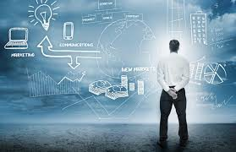
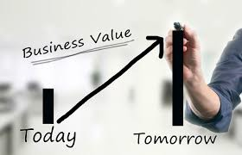
MIS782
Value of Information
Class Week 9

Slide 2
MIS782: Value of information
HOW DO ICT INVESTMENTS GENERATE VALUE?
Firms need to understand: | How to gain competitive advantage based on the their underlying resources. | How competitive advantage from business and how emerging IT opportunities, such as social media analytics, can generate business value from investments in these areas. | Analyse how organisations adapt to changes or disruptors in the technology landscape to preserve and sustain an advantage.
In this unit, we will discuss: | Course One + Two | Course Three + Four | Course Five
 | Business Value Returns from IT Investments IT Portfolio Theory 3. Analysing competitive advantage - RBV 4. Analysing competitive advantage - VRIO | Analytics as a capability - I Business Case Development Analytics as a capability - II: From business data to business insight Emerging sources and SMA | 9. Dynamic capabilities through Information Asymmetries 10. Competing on Information Asymmetries

Slide 3
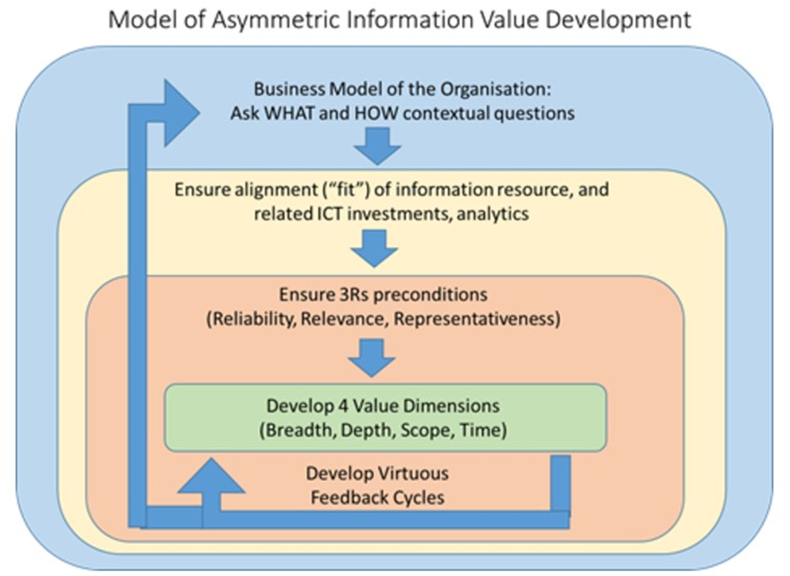
Building Analytical Capability
Developed and presented by Scheepers, R, Straub D, W in 2016

Slide 4
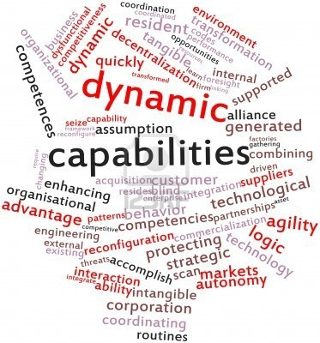
The ‘O’ in VRIO: Dynamic Capabilities
Some definitions first..
 [Dynamic capabilities are…] specific processes firms use to alter their resource base, as sources of competitive advantage (Eisenhardt & Martin, 2000).
 the organisational and strategic routines by which firms achieve new resource configurations as markets emerge, collide, split, evolve, and die.
Notes:
UNDERLYING ASSUMPTIONS IN DYNAMIC CAPABILITIES PERSPECTIVE
Premise that markets are dynamic
•Economic rents due to temporal advantage
•Timing and adaptation is crucial to gaining sustained competitive advantage.

Slide 5
Dynamic Capabilities and Competitive
Advantage
 Dynamic capabilities enable business enterprises to create, deploy, and protect the intangible assets that support superior long-run business performance. (Teece, 2007)
 But only when:
 Markets are dynamic
 Having dynamic capabilities leads to at least a temporary competitive advantage
 Timing and adaptation is correctly aligned with opportunities
What does that tell you about an analytics capability?
Notes:
Databases – C U D
Resource of the firm - three things I can do to my resource and capabilities
Adding things, changing them and dropping things that don’t work
I sense trouble – I look at newspapers I sense trouble. Sense threats and opportunites. SM monitoring. Your current business case for banks

Slide 6
Dynamic Capabilities and Business
Opportunities: 3 Steps
Sensing the opportunity
 Applying analytics capabilities to be aware of emerging technologies, processes, market segments, etc.
Seizing the opportunity
 Having structures, procedures and capabilities to act on what you sense
Transforming the opportunity into business value
 Aligning tangible and intangible resources with the opportunity
Notes:
Dynamic capabilities are, in fact, special types of organisational capabilities.
As part of our discussion on resource-based theory, in Course 2 Step 1.5we outlined the notion of resources and in Course 2 Step 1.6 we outlined capabilities. Dynamic capabilities are simply ‘capabilities that are dynamic’ which means dynamic capabilities have the same dimensions (four dimensions as discussed before) as core capabilities. In this step, we are going to build on this and look at how dynamic capabilities can maximise their competitive value over time.
Dynamic capabilities enable the firm to reconfigure its resources over time, to counteract emerging opportunities and threats. Essentially, dynamic capabilities are processes and routines that an organisation implements to enable them to continuously adapt or reconfigure their resources and capabilities. This ensures their competitive value over time.
Highly competitive markets demand rapid business evolution and as a result, today’s leading organisations are able to:
Respond in a timely manner to changes (e.g. they have dynamic capabilities to sense opportunities or threats);
Engage in rapid and flexible product/service innovation (eg. seizing opportunities); and
Redeploy, reconfigure or transform their core capabilities in response to these opportunities/threats (e.g. competitive imitation, substitution, developments in technology).
See Teece et al for further illustrations of the concepts of sensing, seizing and transforming as depicted in the figure below or open a PDF version in the downloads at the bottom of this step.

Slide 7
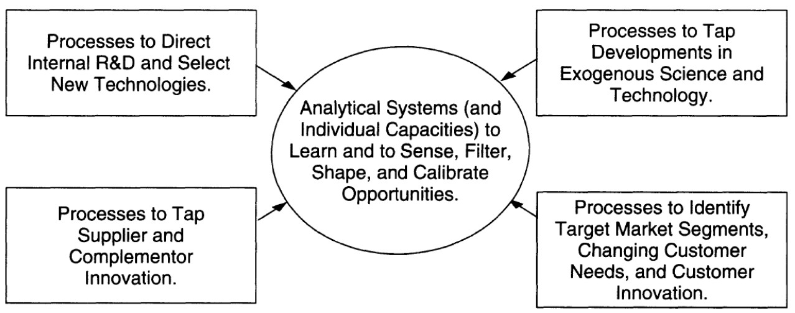
Sensing opportunities
Source: Teece (2007)

Slide 8
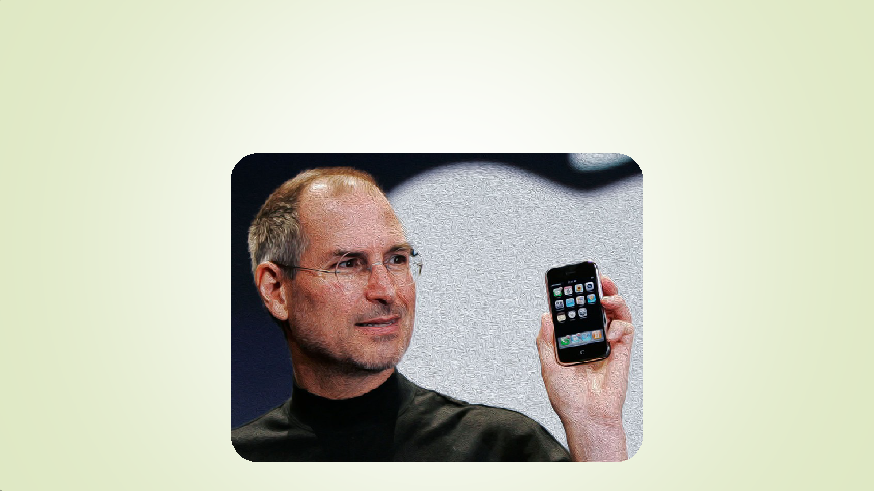

The 3 Steps Applied: Apple’s iPhone
29 July 2007, the first iPhone came out
Notes:
Visicalc – world’s first spreadsheet was created.

Slide 9

What was the opportunity Apple sensed?
Early “smart phones” were clunky and resembled older cell
phones

Slide 10
What capabilities did Apple have for sensing opportunity?
Interactive screens to make phone calls – will they like it?

Slide 11
Social Media Monitoring
Example from research completed here at Deakin….
Social media monitoring to sense new product ideas. They monitor how people use their products. E.g. an organisation selling self-help training….
Notes:
If you can sense how people might use your product that generates an advantage…
Who buys them? stay at home moms. Thinking to re-enter the workforce.
When do they use them? 9.00 -12.00 in the morning (they were talking about their life in social media, dropped the kids at school, time for some) survey responses are very low. (Facebook is selling these information and earning so much money)
Quiet in the house, no kids! People want background music when they are completing these work.

Slide 12
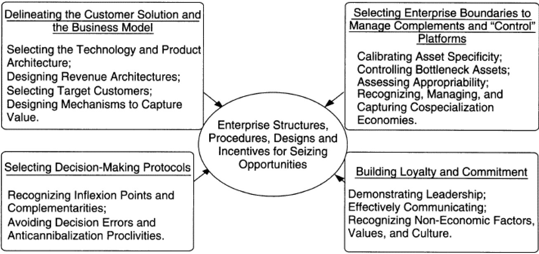
Seizing opportunities
Source: Teece (2007)

Slide 13
How did Apple seize the opportunity?
Creating a phone with a large
screen and an intuitive interface
Promoting the App Store and third
party development

Slide 14
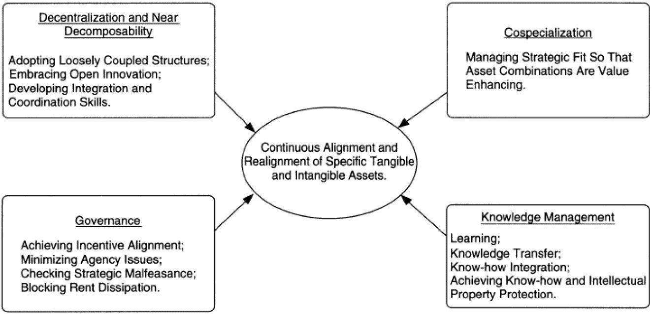
Transforming to Create Value from the
Opportunity
Source: Teece (2007)

Slide 15
How did Apple transform to capture
this value?
Developing telephony
capabilities
Apply existing marketing
capabilities

Slide 16
Result: Sustained Competitive Advantage
What can Apple do now, as its
global share of this industry further
decreases?

Slide 17
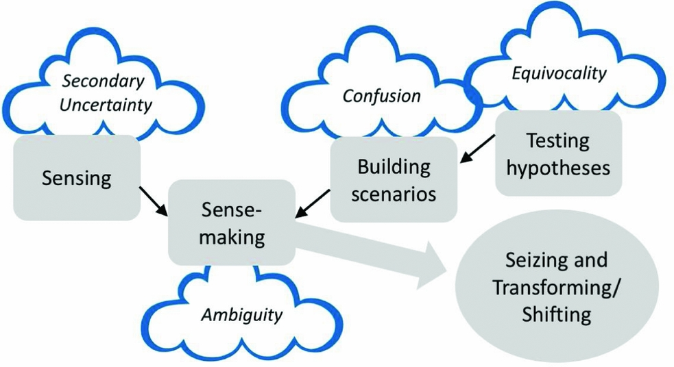
Dynamic capabilities in an uncertain world
RPaul Schoemaker's "Innovation, Dynamic Capabilities, and Leadership" , California Management Review Volume 61, Issue 1 (Fall 2018)
Let’s listen to a brief intro to this article: https://www.youtube.com/watch?v=stG6-nPZapU
Note: This framework is an elaboration of Teece (2007) and Cox, Raspin, and Teece (2018).
Figure 1. Management Under Uncertainty: Sensing and Sensemaking

Slide 18
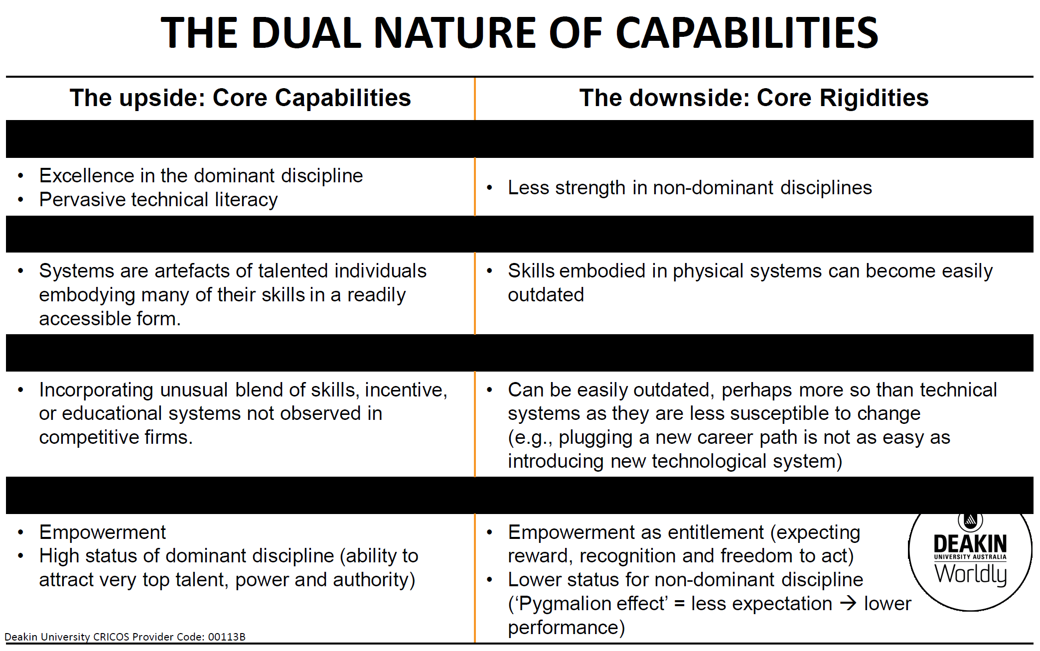

Slide 19
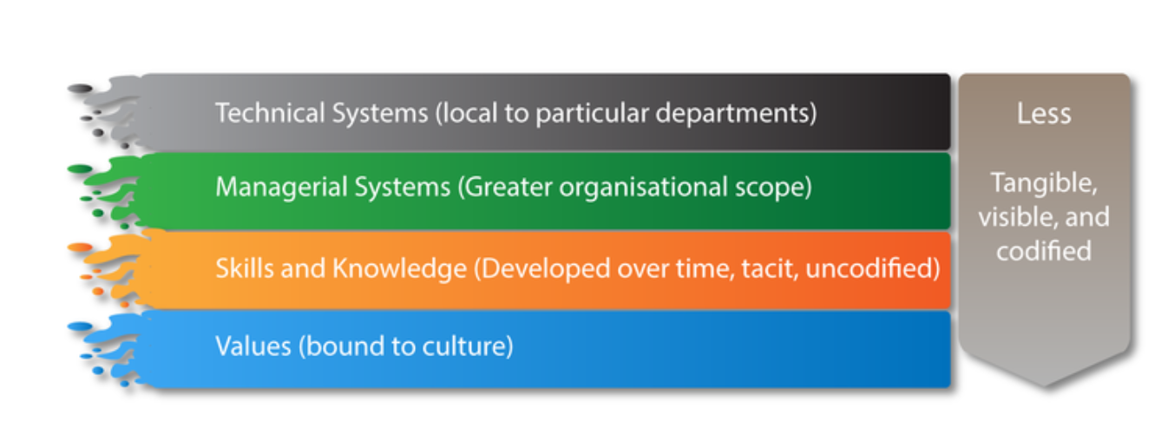
What DEFINES THE SEVERITY OF CORE RIGIDITIES?
The severity depends upon:
a)The number of dimensions comprising a core rigidity
b)The type of dimension comprising a core rigidity
The four dimensions vary in ease of change:
Notes:
Capabilities are considered core if they differentiate a company strategically but core capabilities can become core rigidities.
Consider companies like Kodak, Remington Typewriters where the core capabilities no longer enabled the company to produce value for the business. That is, word processors replaced typewriters and film-based photography went digital. Since their core capabilities drove their profit, it didn’t allow for innovation and therefore when the world moved on they were unable to transition.
‘… core capabilities have a down side that inhibits innovation, here called core rigidities. Managers thus face a paradox: how to take advantage of core capabilities without being hampered by their dysfunctional flip side.’ (Leonard-Barton, 1992, p. 111)
The severity of core rigidity depends upon:
a) The number of dimensions comprising a core rigidity
b) The type of dimension comprising a core rigidity
The four dimensions vary in ease of change as seen below, skills embodied in physical or technical systems can become easily outdated.

Slide 20
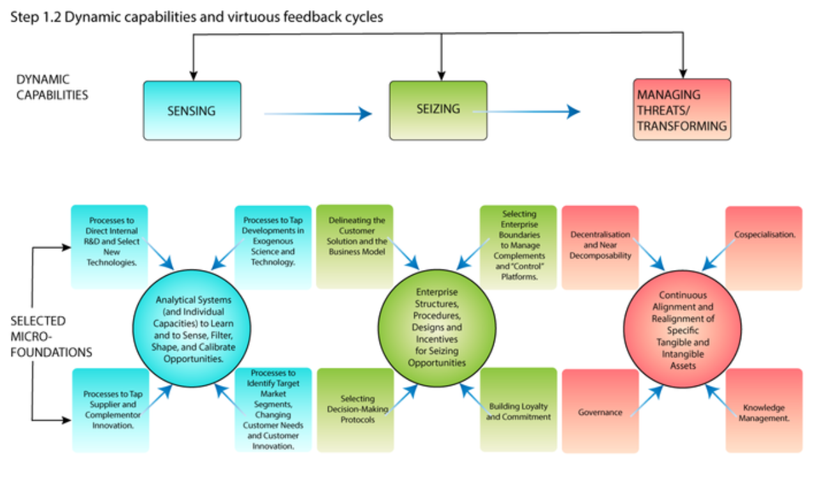

Slide 21
APPLICATION
How Tesla ‘sensed’ the evolution of car industry (EVs as an emerging market), ‘seized’ it as an opportunity, and ‘reconfigured’ its internal and external competences in order to gain sustained competitive advantage?
https://www.youtube.com/watch?v=-UziAXis9yg
Find out how tesla reshaped automobile industry: going beyond electric cars, to autonomous cars, to connected cars to personal mobility services.

Slide 22
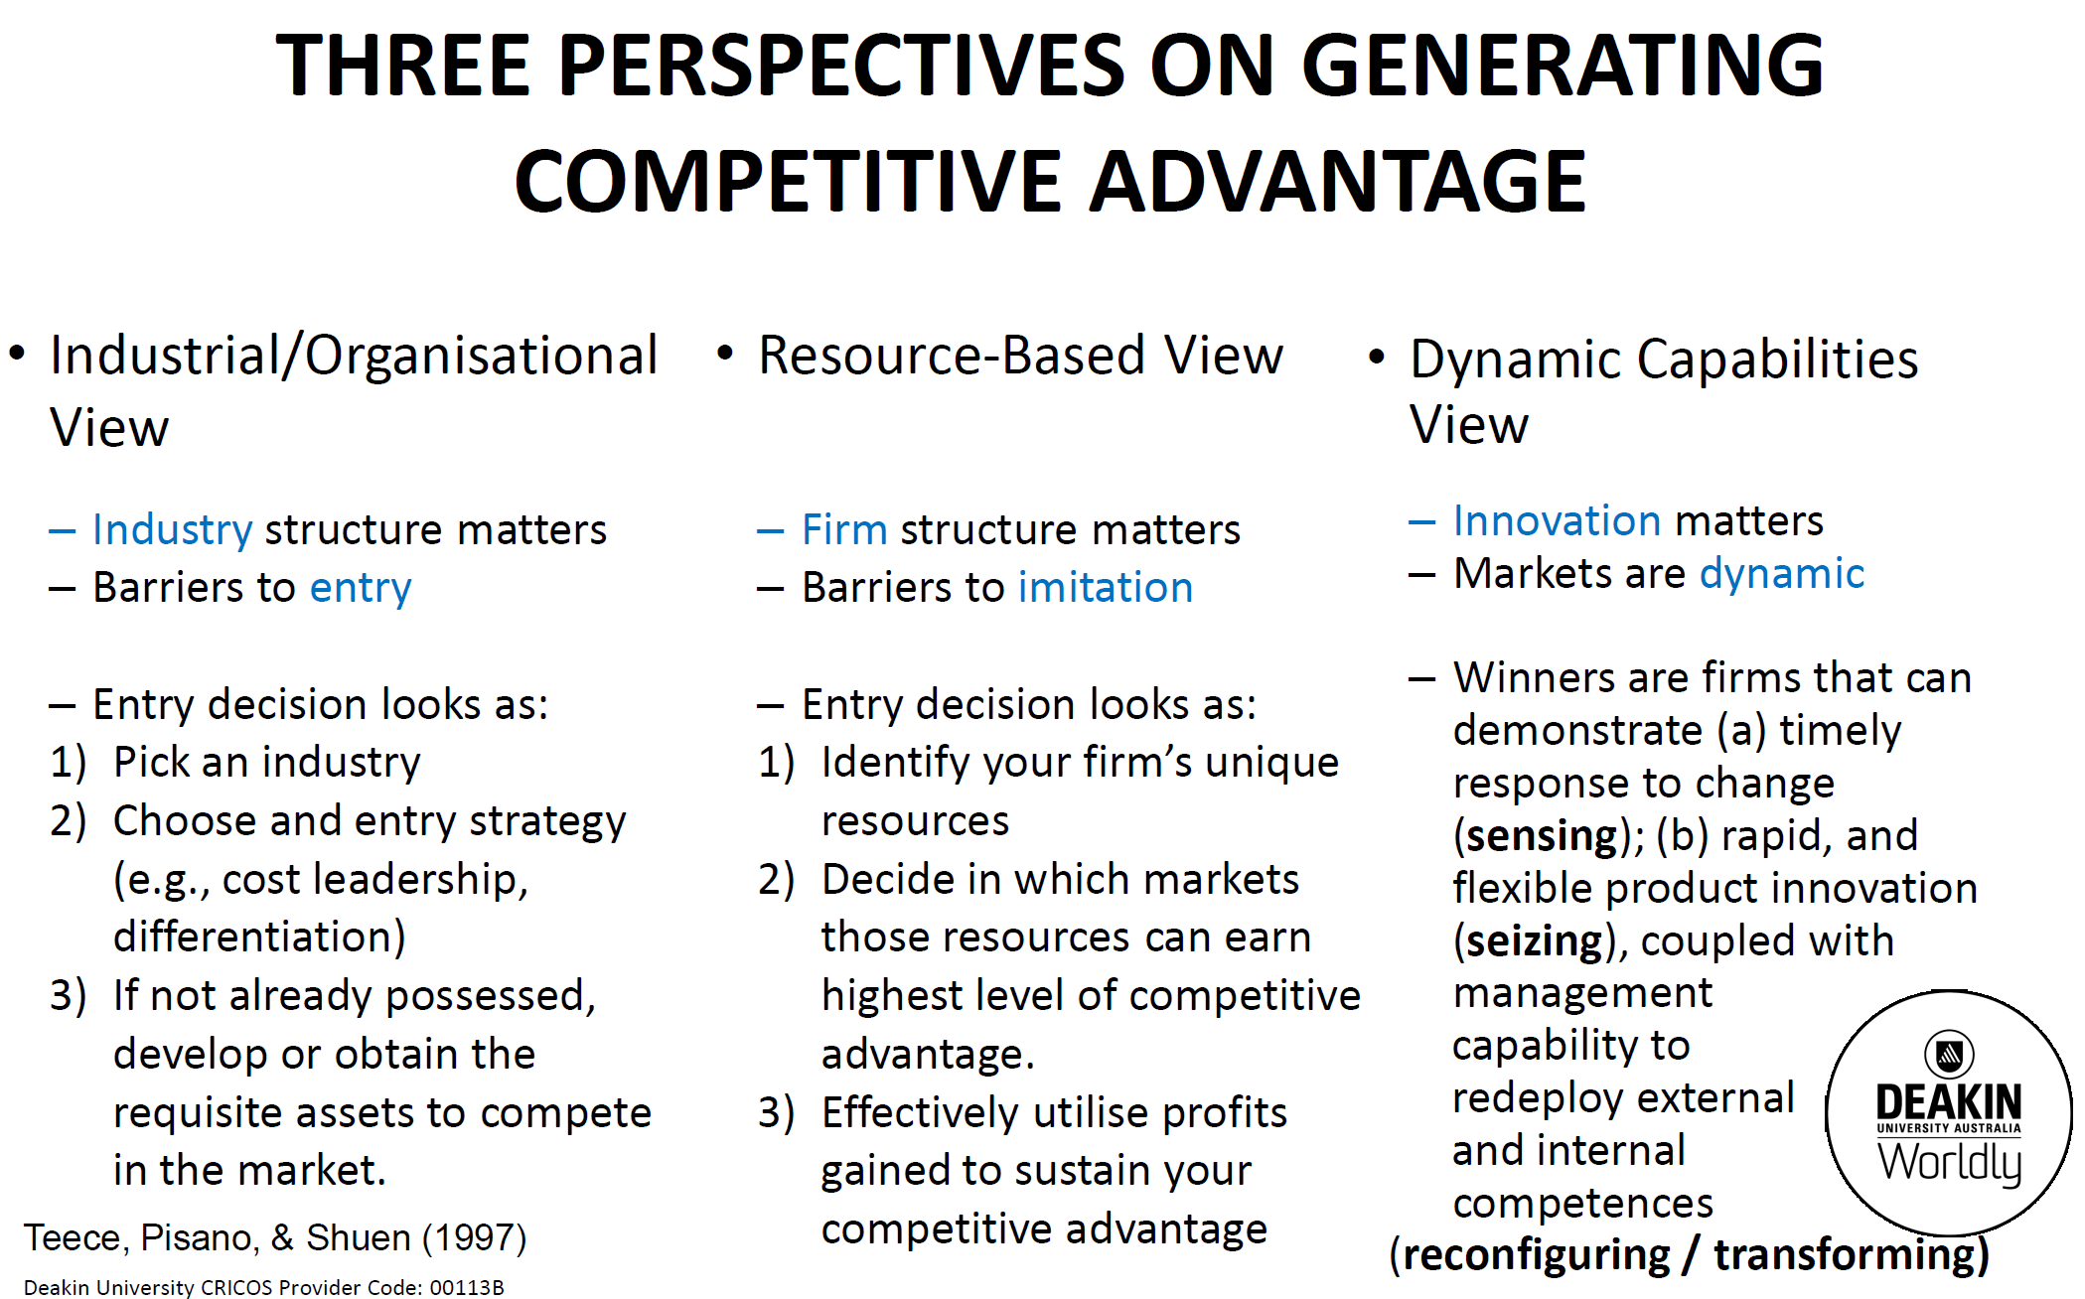

Slide 23
Application
Samsung and dynamic capabilities
https://www.youtube.com/watch?v=qmY41eibkFA

